Slide 1
Mullerian anomalies
SIG Endocrinology 2019
Chairperson – Madhuri Patil

Slide 2
The ESHRE/ESGE classification system
Has the following general characteristics
Anatomy is the basis for the systematic categorization of anomalies.
Deviations of uterine anatomy deriving from the same embryo- logical origin are the basis for the design of the main classes.
Anatomical variations of the main classes expressing different degrees of uterine deformity and being clinically significant are the basis for the design of the main sub-classes.
Cervical and vaginal anomalies are classified in independent supplementary sub-classes
Human Reproduction, Vol.28, No.8 pp. 2032–2044, 2013

Slide 3
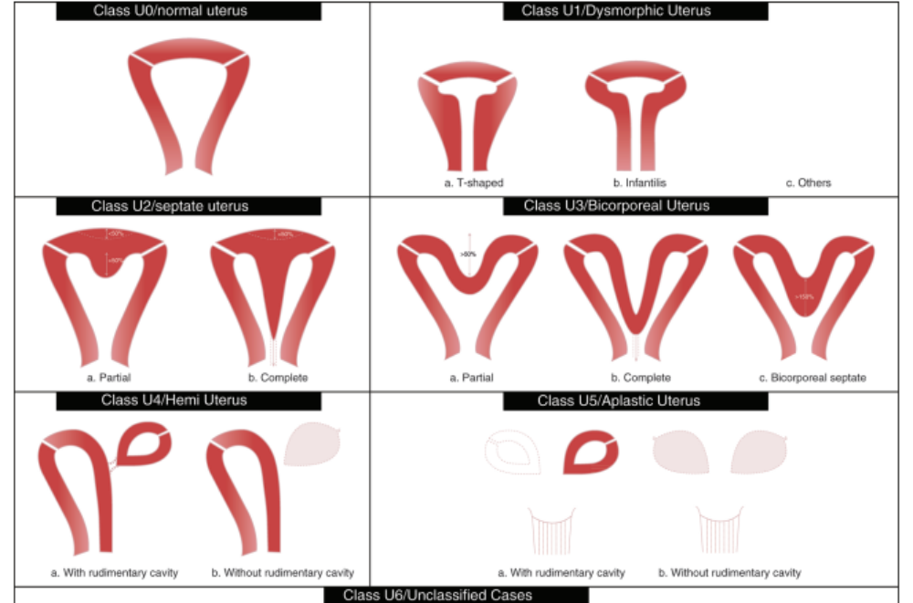
ESHRE/ESGE classification of uterine anomalies: schematic representation
Human Reproduction, Vol.28, No.8 pp. 2032–2044, 2013

Slide 4
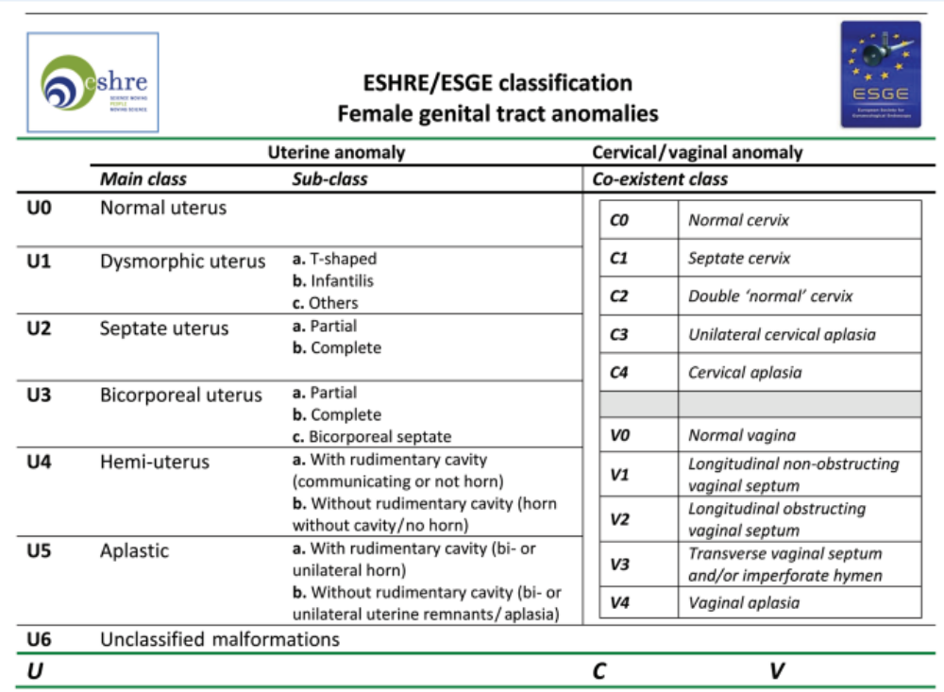

Slide 5
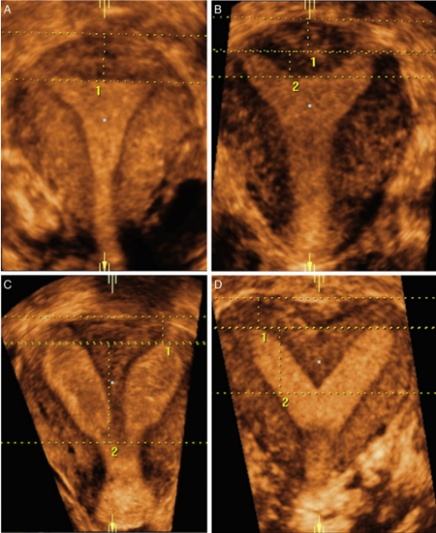
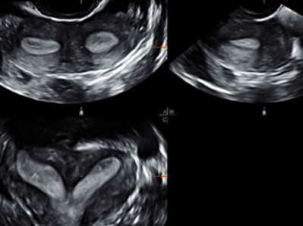
Diagnosis of female genital anomalies
Gynecological examination with careful evaluation and recording of the external genitalia, vaginal and cervical anatomy.
2D TV US in a predefined and systematic manner where the shape and dimensions of the uterine cavity, uterine wall and external uterine contour should be recorded
Measurements from 2D US examination could be used as a reference for the evaluation of uterine anatomy deviations in 3D ultrasound.
3D TV US in a predefined and systematic manner where the shape and the deviations from normal cervical and uterine anatomy should be recorded and documented
Patients with - subfertility, recurrent IVF failures or recurrent pregnancy losses
HyCoSy or 2D or 3D SHG
MRI
Hysteroscopy and Laparoscopy
in the context of concomitant surgical treatment of any discovered pathology only by endoscopic surgeons with experience in management of complex female genital anomalies
Normal
Partial Septum
CompleteSeptum
Bicornuate
Human Reproduction, Vol.31, No.1 pp. 2–7, 2016

Slide 6
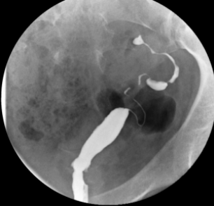
Unicornuate uterus
Careful evaluation for a rudimentary horn or a possible vaginal septum and associated complete contralateral duplication is required
Expectant management is warranted if the patient’s history is unremarkable, that is, no previous episodes of repeated pregnancy loss, second-trimester loss, preterm labour or preterm birth have occurred
Rudimentary Horn
Functioning endometrium - Consideration should be given to removing the horn if the horn is non- communicating
Horn communicates with the cervix - individualization of care is warrante In most cases, the horn will be small and although the prospect of pregnancy and live birth low, surgical intervention is warranted. In this setting, excision may be required
There are no surgical options for the unicornuate uterus - monitored as if at risk for preterm labour, preterm rupture of the membranes, preterm dilatation or cervical incompetence by serial clinical examinations and ultrasound examinations measuring the cervical length
No functioning endometrium and only a rudimentary non-communicating horn present - No intervention is needed

Slide 7
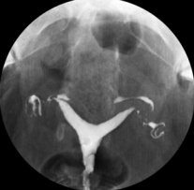
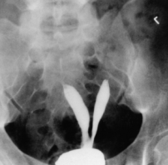
Septate Uterus
Hysteroscopic approach
Trans-abdominal approach
Post-operative interventions
Assisted reproduction treatment
Using microscissors, laser fibres or resectoscopic loop is the least invasive approach. These techniques may be performed with either laparoscopic or transabdominal ultrasound guidance
If hysteroscopic resection of a septum is impossible or incomplete after several attempts, a transabdominal approach may be required, depending on the degree of persistence, using a Jones or a Tompkins metroplasty
Placement of a balloon or supplemental high dose oestrogen to minimize adhesion formation.
Re- Evaluation of the cavity through hysteroscopy,SIS or HSG to make certain that the cavity has been restored to normal in depth, breath and width
Before ART - septum should be removed and normalcy of the endometrial cavity after surgery verified
More aggressive approach and recommend excision rather than observation

Slide 8
Bicornuate Uterus
Evaluation for pregnancy loss or adverse obstetric outcome
If detected, consideration may be given to surgery and unification
Careful patient selection is essential
Routine evaluation
In either case, aggressive prenatal monitoring for early signs of preterm labour, such as cervical length shortening, or intrauterine growth restriction is required.
Pregnancy
If duplication is detected on clinical examination or incidentally during imaging studies for other clinical indications, no intervention is warranted

